Slide 1
“The Gifts of the Spirit”
“The Tools of Our Trade”
2025
Introduction to the Series
By Andy Acreman
Notes:
Several people in TCF have ask for this series, independently of each other. We believe that a might move of God is close in our borough, and we need to be practised in using the gifts of the Spirit to maximise the expansion of the Kingdom of Heaven into the lives of those around us.
First, let’s read aloud some of the relevant bible passages that describe them…

Slide 2
1 Corinthians 12 vv 1-11
Now about the gifts of the Spirit, brothers and sisters, I do not want you to be uninformed…
⁴ There are different kinds of gifts, but the same Spirit distributes them. ⁵ There are different kinds of service, but the same Lord. ⁶ There are different kinds of working, but in all of them and in everyone it is the same God at work.

Slide 3
1 Corinthians 12 vv 1-11 (cont.)
⁷ Now to each one the manifestation of the Spirit is given for the common good. ⁸ To one there is given through the Spirit a message of wisdom, to another a message of knowledge by means of the same Spirit, ⁹ to another faith by the same Spirit, to another gifts of healing by that one Spirit, ¹⁰ to another miraculous powers, to another prophecy, to another distinguishing between spirits, to another speaking in different kinds of tongues, and to still another the interpretation of tongues. ¹¹ All these are the work of one and the same Spirit, and he distributes them to each one, just as he determines.

Slide 4
1 Corinthians 12 vv 12-14, 27, 31
¹² Just as a body, though one, has many parts, but all its many parts form one body, so it is with Christ. ¹³ For we were all baptized into one Spirit so as to form one body—whether Jews or Gentiles, slave or free—and we were all given the one Spirit to drink. ¹⁴ Even so the body is not made up of one part but of many…
²⁷ Now you are the body of Christ, and each one of you is a part of it… [then follows a list of ministries / gifts]
³¹ Now eagerly desire the greater gifts.
And yet I will show you the most excellent way…

Slide 5
Romans 12:6-8 NIV
We have different gifts, according to the grace given to each of us. If your gift is prophesying, then prophesy in accordance with your faith; ⁷ if it is serving, then serve; if it is teaching, then teach; ⁸ if it is to encourage, then give encouragement; if it is giving, then give generously; if it is to lead, do it diligently; if it is to show mercy, do it cheerfully.
Ephesians 4:11-13 NIV
So Christ himself gave the apostles, the prophets, the evangelists, the pastors and teachers, ¹² to equip his people for works of service, so that the body of Christ may be built up ¹³ until we all reach unity in the faith and in the knowledge of the Son of God and become mature, attaining to the whole measure of the fullness of Christ.

Slide 6
1. Unity is the Point!
Jesus will only return for a united Bride – the church
Unity is powerful and beautiful – disunity is ugly!
E.g. Cricket, Orchestra, the Army.
Jesus prayed for our unity – John 17:22-23…
²² I have given them the glory that you gave me, that they may be one as we are one— ²³ I in them and you in me—so that they may be brought to complete unity. Then the world will know that you sent me and have loved them even as you have loved me.
Notes:
What can we learn from the Word of God?
The job of the Holy Spirit to unite the Body of Christ – the church. We are united already in spirit, and so we must live up to that unity in our everyday lives and relationships. This is just one example of bringing heaven to earth!

Slide 7
2. Equal Value
God places equal value on every Christian…
²⁶ So in Christ Jesus you are all children of God through faith, ²⁷ for all of you who were baptized into Christ have clothed yourselves with Christ. ²⁸ There is neither Jew nor Gentile, neither slave nor free, nor is there male and female, for you are all one in Christ Jesus. ²⁹ If you belong to Christ, then you are Abraham’s seed, and heirs according to the promise. (Galatians 3)
⁹ After this I looked, and there before me was a great multitude that no one could count, from every nation, tribe, people and language, standing before the throne and before the Lamb. They were wearing white robes and were holding palm branches in their hands. (Revelation 7)
Notes:
This is really really important. We cannot understand the point of spiritual gifts unless we grasp this.

Slide 8
3. No Favouritism / Power of Diversity
³⁴ Then Peter began to speak: “I now realise how true it is that God does not show favouritism ³⁵ but accepts from every nation the one who fears him and does what is right. (Acts 10)
We can then celebrate and emphasise our human diversity without being misunderstood or feared
Similarly, diversity of spiritual gifting produces inter-dependence which unites us. LIKE GLUE !!!
A team with different specialisms is much stronger
God uses spiritual gifts and ministries in his church to make his united Body strong, therefore
Notes:
As we recognise that we all have equal worth and value in God’s eyes – with no favouritism on his part - we can emphasise and celebrate our differences without being misunderstood or feared.
Diversity of spiritual gifting and ministry promotes interdependence – we depend on one another – and the mutual dependence is a method by which God unites us. GLUE! This is even true in everyday life. People who are fiercely independent and don’t seem to have a need of anyone, normally struggle to form meaningful relationships.
Specialists make a more powerful unit, so long as they work well together.
But a team of all-rounders is weak; and a team of just one specialism is dangerous!
Gifts and Ministries is how God does this – the diversity of the Bride makes her stronger.

Slide 9
4. The Greatest Gift and His Gifts…
The Giver of the gifts is Himself a Gift to us…
⁴ On one occasion, while he was eating with them, he gave them this command: “Do not leave Jerusalem, but wait for the gift my Father promised, which you have heard me speak about. ⁵ For John baptized with water, but in a few days you will be baptized with the Holy Spirit.” (Acts 1)
The spiritual gifts are called charismata (grace gifts)
These gifts come through us; they ‘shine’ (‘phanerosis’)
Our personal set of gifts is unique – so we are essential!
The gifts are our ‘tools’ to serve God and one another; as we offer ourselves to God, we then becomes gifts to the church – called ‘Ministries’
Notes:
The Giver of the Gifts is the Holy Spirit, and He is a gift in Himself – given to each of us. (Acts 1:4-5). He lives inside each Christian believer. “There’s something about you…”.
These ‘tools’, these ‘Spiritual Gifts’ (charismata or ‘grace gifts’) are found in several places in the New Testament, including Romans 12, 1 Corinthians 12, 13, and 14.
They are given by the Spirit of God, though each of us (phanerosis or ‘shining forth’) , to an individual or the whole Body, in order to build them up in their faith. So, we need to think of ourselves as channels of his grace, rather than just the recipients of it. He shines through us!
Very clearly, our personal gift or groups of gifts is unique; no-one has everything. That gives every one of us a vital role in God’s church.
A “Ministry” is a person, who is called by Jesus, devoted to God, with a vision, and with a collection of gifts from the Spirit; just as a skilled tradesman has high quality tools in his/her bag. Some tools are similar between different trades. Having received these gifts, the spiritual ‘tradesman’ becomes themselves a gift to the church.

Slide 10

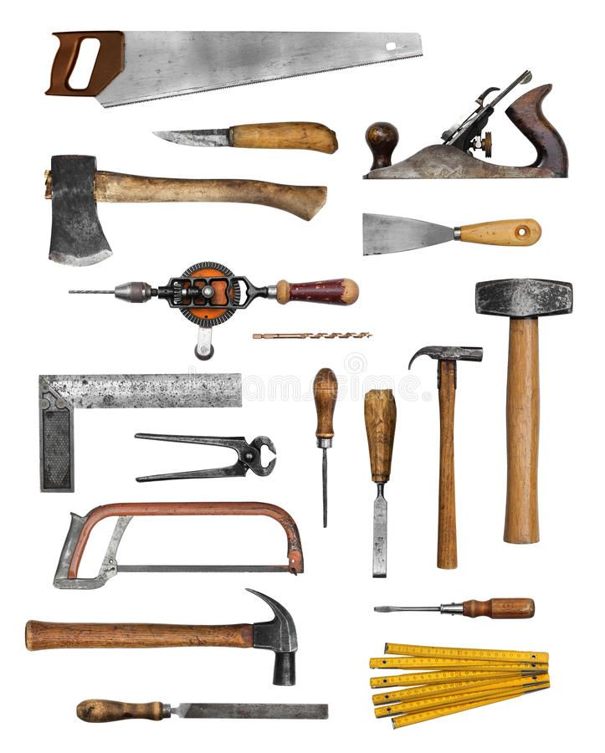
5. A Workman’s Tools
Notes:
If you don’t have the right tools, you cannot do the job properly, no matter how skilled and committed you are as a person. The same applies to spiritual gifts and ministries:
E.g. Somone who regularly serves as a prophet may have Prophecy, Message of Knowledge, and Discernment of spirits in their ‘toolbox’.
Yes, we can all use these tools from time to time – in fact, God encourages us to do so – but to become a specialist, you must learn to use the right set of God-given tools / gifts and learn to serve the Body of Christ faithfully and consistently.

Slide 11
6. How Do We Use These Tools?…
³¹ Now eagerly desire the greater gifts. And yet I will show you the most excellent way. (1 Corinthians 12)
¹ If I speak in the tongues of men or of angels, but do not have love, I am only a resounding gong or a clanging cymbal. ² If I have the gift of prophecy and can fathom all mysteries and all knowledge, and if I have a faith that can move mountains, but do not have love, I am nothing…
⁸ Love never fails. But where there are prophecies, they will cease; where there are tongues, they will be stilled; where there is knowledge, it will pass away. ⁹ For we know in part and we prophesy in part, ¹⁰ but when completeness comes, what is in part disappears… (1 Corinthians 13)
¹ Follow the way of love and eagerly desire gifts of the Spirit, especially prophecy. (1 Corinthians 14)
Notes:
There is a way of using these powerful spiritual gifts that is God’s way and does not cause people any harm. So what does the Bible say about it?

Slide 12
The Only Way Is Love…
Love is not an alternative to the gifts of the Spirit, but the only way in which they should be exercised
We should exercise these gifts in an attitude of love and respect for one another – it’s not a competition!
These gifts will not last for ever – but love will
Notes:
“The Only Way Is NOT Essex, but LOVE”.
You would not give an electric drill or circular saw to a 5-year-old child, because they do not have the maturity to use it – they will damage themselves and others.
We can only use the gifts of the Spirit in a loving way…
The gifts help us on the journey; LOVE is the destination!

Slide 13
Categories of Gift - 1…
Gifts of Revelation (through our thoughts):
  Message of wisdom
  Message of knowledge
  Distinguishing between spirits
Gifts of Declaration (through our voice):
  Prophecy
  Tongues
  Interpretation of tongues
Gifts of Power (actions):
  Miracles
  Healings
  Faith
Notes:
What Spiritual Gifts are available?
In 1 Corinthians, they are very ‘supernatural’ / miraculous, even. Impossible to do if you are not a Spirit-filled believer.
We can categorise them as follows…

Slide 14
Categories of Gift -2…
Romans 12
  Prophecy
  Serving
  Teaching
  Encouraging
  Giving
  Leading
  Showing Mercy
Ephesians 4
  Apostles • Shepherds
  Prophets • Teachers
  Evangelists
Notes:
The list in Romans 12 is quite different – only Prophecy appears in both lists.
Whilst the power comes from God, they are things that non-Christian people can do to some extent.
But they are equally vital, even if they are less spectacular
The list in Ephesians 4 is about “Ministries” / people who serve. The subject of a further teaching series!

Slide 15
Order! Order!
²⁶ What then shall we say, brothers and sisters? When you come together, each of you has a hymn, or a word of instruction, a revelation, a tongue or an interpretation. Everything must be done so that the church may be built up…
²⁹ Two or three prophets should speak, and the others should weigh carefully what is said. ³⁰ And if a revelation comes to someone who is sitting down, the first speaker should stop. ³¹ For you can all prophesy in turn so that everyone may be instructed and encouraged. ³² The spirits of prophets are subject to the control of prophets. ³³ For God is not a God of disorder but of peace—as in all the congregations of the Lord’s people…
³⁹ Therefore, my brothers and sisters, be eager to prophesy, and do not forbid speaking in tongues. ⁴⁰ But everything should be done in a fitting and orderly way. (1 Corinthians 14)
Notes:
1 Corinthians 14 focusses specifically on Prophecy, Tongues and Interpretation – explaining how these gifts should operate and emphasising that the exercise of all the gifts must be done in an orderly manner, under the authority of godly leadership and in line with the bible’s teachings.
The main focus of a local church’s meeting should be the sharing of spiritual gifts like this. So we all need to come along prepared to share something. Saturday evening is a key time in our week! Let’s eagerly desire to be used by the Lord in this way.
I long for the day when there is such an amazing outpouring of God’s grace gifts that disorderliness becomes even a possibility! Until then, let’s all focus on the manifestation of the Spirit, and let the leaders worry about orderliness in our meetings!

Slide 16
Executive Summary
Jesus seeks a united Bride – His complete Church
We are all of equal value to Him – no favourites!
Differences are a strength and should be treasured
We have all received the Holy Spirit as a gift
He ‘shines’ his diverse gifts through us – for others
We ourselves are ‘gifts’ to the church – ‘ministries’
Aim to exercise the gifts in a Christlike way (‘Love’)
Eagerly desire to exercise supernatural spiritual gifts
Look at one or two gifts per week this term

Slide 17
Be Filled With The Holy Spirit
Let’s pray for one another now, to be filled afresh (or for the first time) with the Holy Spirit
AND
To be made hungry to receive and use some of these spiritual gifts.

